Slide 1
Generating and Revealing AutoStereograms
Tyler Niles
ENGG8840
March 25th, 2010

Slide 2
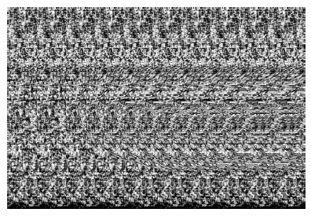

Slide 5
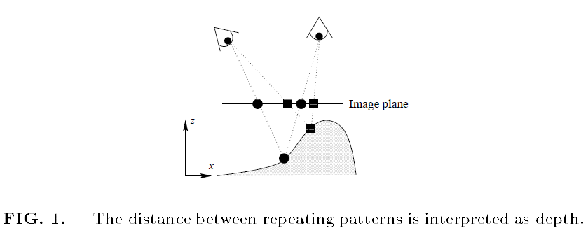

Slide 6
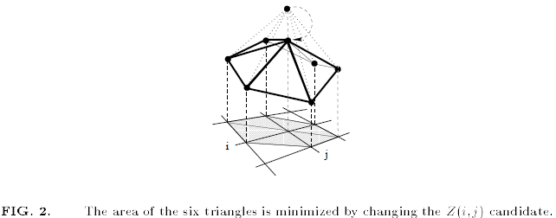

Slide 7
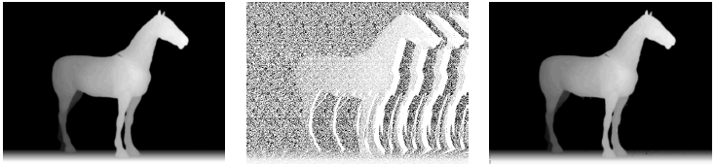

Slide 8
Euler-Lagrange
Steepest Descent Flow

Slide 9
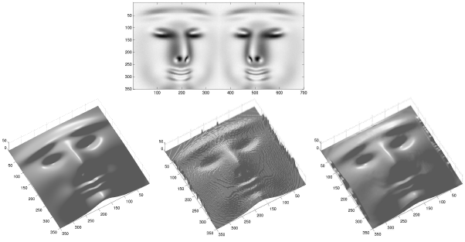

Slide 10
Propose:
1. Create a program to Generate stereograms given a grayscale image
2. Create a program to decipher stereograms given a grayscale stereogram

